Slide 1

DYNAMIC CRM SOLUTIONS & BUILD AUTOMATION

Slide 2
Agenda
Overview of CRM Solution
Managed vs unmanaged solution
Solution organization strategies
Deployment Demo
Why Automation ?
Overview of Solution Packager
Overview of CRM Build Automation
Demo of CRM Build Automation

Slide 3
CRM Solution
Solutions in Microsoft Dynamics CRM is a method to let you group and manage your custom components for a particular set of functionality or release.
Solutions consist of CRM Metadata and custom code.
CRM Metadata includes the definitions of: CRM entities, forms, views, charts, relationships, etc. Workflows Dashboards Templates Security Roles and Field Security Profiles And a few more customization types…

Slide 4
Unmanaged Solution
Unmanaged solution allows the solution to be modified after it is imported. Unmanaged solution is still under development stage and it is not intended to be distributed or installed.
All the elements or components in the solution can be customized without any restriction.
An unmanaged solution can be exported.
When the unmanaged solution is completed and ready to distribute it, export it and package it as a managed solution.
Unmanaged solution files can be transported from one environment to the other.
Entities, Fields, web resources can be removed manually.
The solution acts as a container for the components. If user deletes the solution the components still exist in the default solution.

Slide 5
Managed Solution
A managed solution is a completed solution in which the solution is prevented from being modified in the environment to which it is imported. A managed solution is intended to be distributed and installed.
Possible to set granular levels of rights to alter elements of the solution such as create views, change field properties, add fields etc.
Solution cannot be exported.
Easier administration with new versions. Any changes including field removal will be rendered
If the solution is removed all the customizations pertaining to that solution will be removed and there will be a Risk of data loss.

Slide 6
Release/version/sprint Solutions
You can organize solutions to releases/phases/sprints, including the changes for each major release of functionality. During development it’s easy for developers to work with the solution.
The release solution can lead to many solution files because solutions are not reused but it can stop solution files becoming too large.
Release 1.0.0.0
Release 1.0.0.1
Release 2.0.0.0

Slide 7
Release/version/sprint Solutions
Advantages
You see what changes were in each release/version/sprint
You deploy smaller solutions, containing only customizations which changed
It’s easy to understand
Disadvantages
You can end up with ever-growing collection of solutions
It can take a long time to create new environments because you need to import each solution in order
The solutions depend on previous versions
Solutions can be confusing because they don’t contain all the customizations being used, it’s difficult to navigate to the right customization

Slide 8
One Solution
You just have one solution containing all customizations
Advantages
Simple
Simple to navigate
Disadvantages
The solution can grow in size and there are some size restrictions
Potentially complex having all customizations in one solution
The solution can take a long time to import
Historically there are problems with solution timing out (before CRM 2016)

Slide 9

Deployment Demo

Slide 10
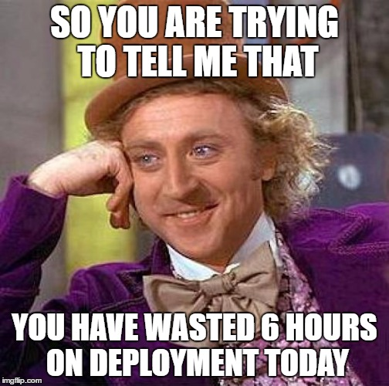
Why Build Automation ?
Manual deployments are boring
Manual deployments take a lot of time
Manual deployments can go wrong due to use error
It‘s a waste of developer’s time.
More environments more time wasted

Slide 11
Solution Packager
SolutionPackager is the tool that can reversibly decompose a Microsoft Dynamics CRM compressed solution file into multiple XML files and other files so that these files can be easily managed by a source control system and vice-versa.
Application Lifecycle Management (ALM): By splitting the solutions customizations file into smaller parts which can be stored in a source control system, it gives us the possibility to re-create the solution at any given code commit which is almost indispensable when making/maintaining software solution.
Multiple developers: It will also allow several people working with their own local solution and when a component is ready, then merge into the staging solution which will be built and deployed to a TEST solution and afterwards to PROD.

Slide 12
Solution Packager
It exists in the CRM SDK path (bin/SolutionPackager.exe)
Usage SolutionPackager /action:[extract/pack] / zipfile [solution zip file] / folder: [Folder to extract]
Example SolutionPackager /action:extract / zipfile Test.zip/ folder: C:\Test\src

Slide 13
CRM Build Automation
CRM Builds can be automated by using combination of various tools.
Our demo uses the following
Dynamic 365
Solution Packager
Visual Studio Online (TFS Online)
XRM CI Framework
Git Client (Like: Tortoisegit)

Slide 14
CRM Build Automation Demo

Slide 15
References
https://msdn.microsoft.com/en-in/library/gg334576.aspx
https://msdn.microsoft.com/en-us/library/jj602987.aspx
https://github.com/WaelHamze/xrm-ci-framework

Slide 16


Slide 17
Thank You ☺

